Slide 1






Project Presentation on
Audible
By Jatin Limaye

Slide 2


INTRODUCTION
Power Query Editor is an essential tool in data processing, especially when it comes to cleaning and transforming datasets. It offers a user-friendly interface that simplifies the data cleaning process through a series of intuitive steps. Users can import data from various sources, such as spreadsheets, databases, or web services, and then apply transformations to standardize and refine the data.

Slide 3

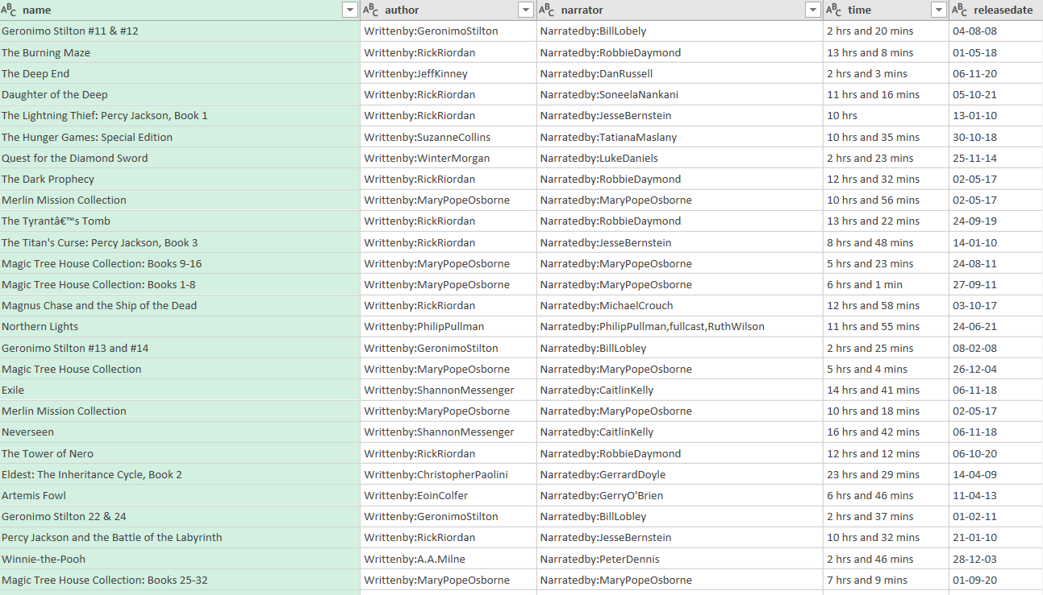


Uncleaned Data

Slide 4



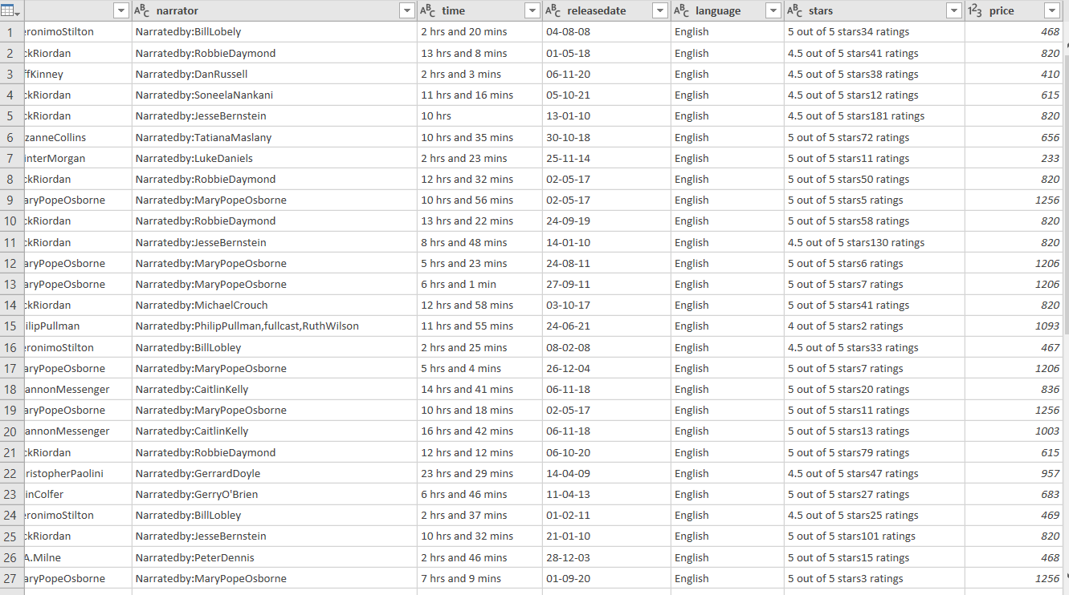

Uncleaned Data

Slide 5
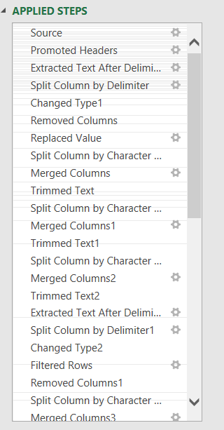


Applied Steps

Slide 6
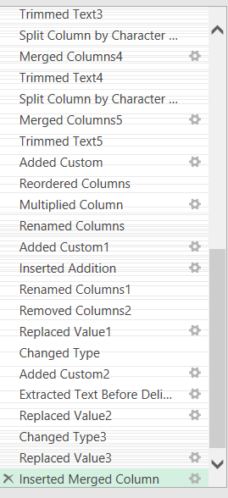
Applied Steps

Slide 7
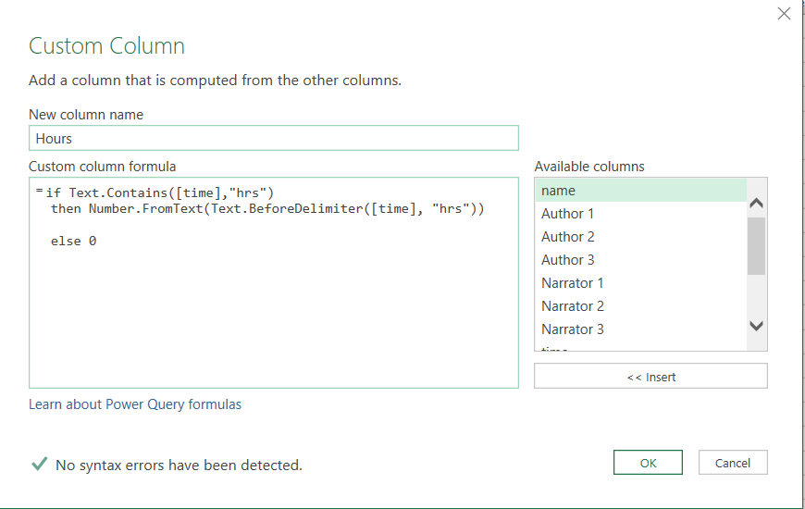


Customs Colums and Formulas
This are the following formulas and created columns which are used in making data properly clean

Slide 8
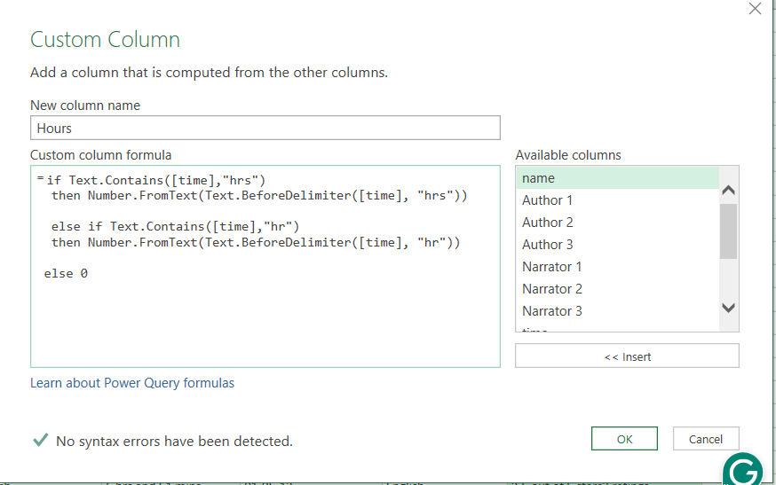
Customs Colums and Formulas

Slide 9
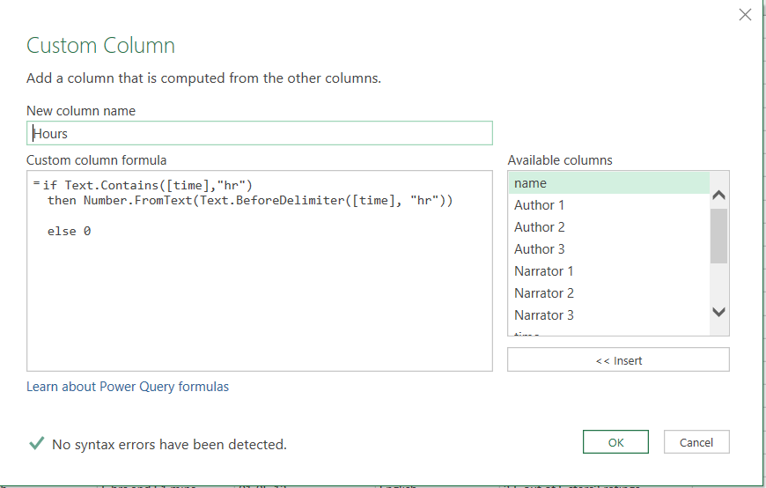


Customs Colums and Formulas

Slide 10
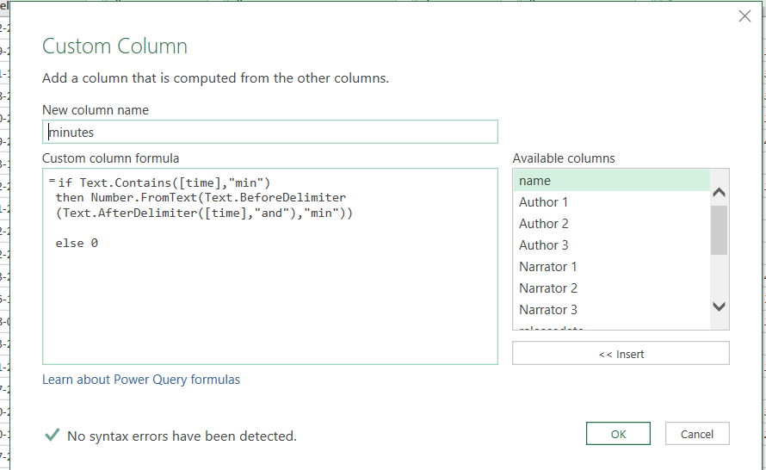
Customs Colums and Formulas

Slide 11
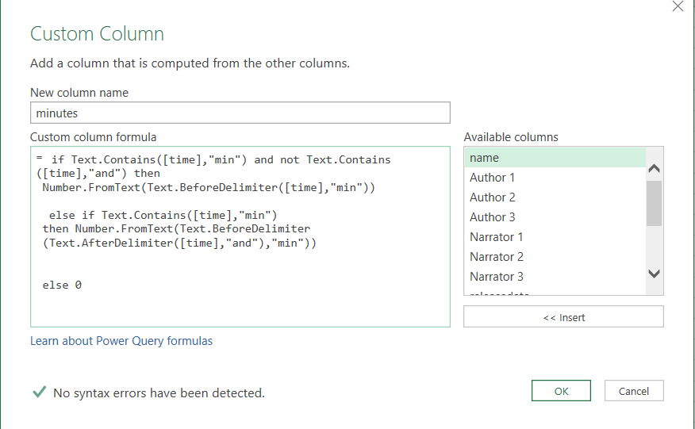

Customs Colums and Formulas

Slide 12
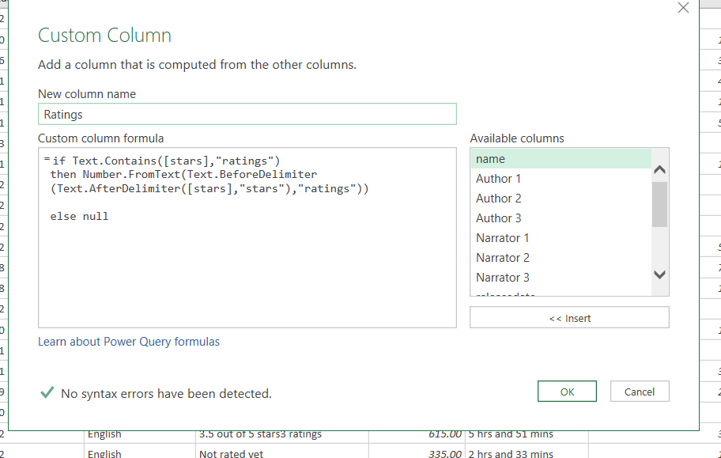


Customs Colums and Formulas

Slide 13

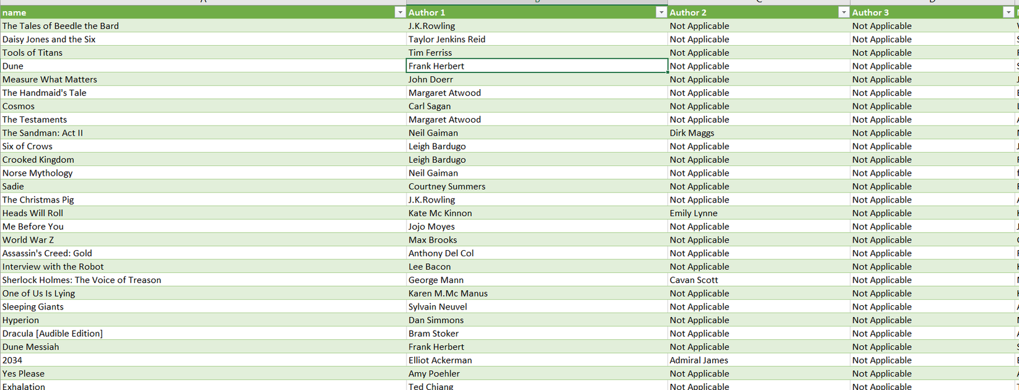

Cleaned Data

Slide 14
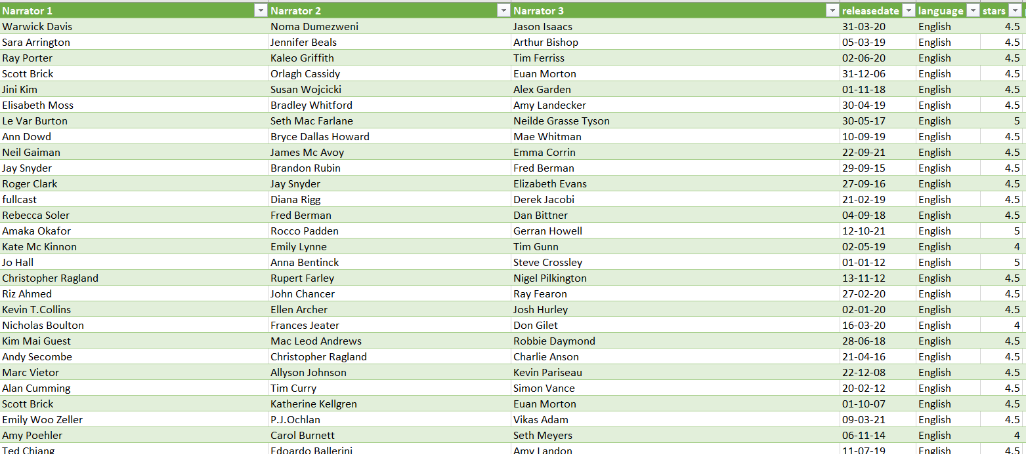
Cleaned Data

Slide 15
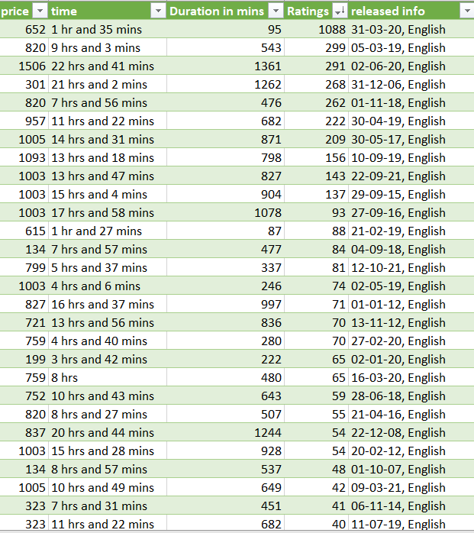
Cleaned Data

Slide 16
If you Like my Content then share with your friends
Thank you
File Link

